Slide 1
Capstone Project: Biodiversity in National Parks
Prepared by:
Bob Okony
Codecademy Capstone Project – Analyze Data with Python

Slide 2
Overview of Project
The National Parks Service has engaged Codecademy Students to perform data analysis on the conservation statuses of species data. The primary focus is to investigate the data files and determine if there are any patterns or themes to the types of species that become endangered. Additionally, analysis is performed on observations of Sheep at several national parks. The project will analyze, clean up, and plot data, pose questions and seek to answer them in a meaningful way.
All work is done in Python 3 using Pandas library within a Jupyter notebook.
This presentation provides and project overview, high level observations and recommendations.

Slide 3
Preliminary Data Analysis
Two data files provided
species_info.csv – contains data on species, scientific name and common name of the species
observations.csv – recordings of sightings for different species at several national parks for the past 7 days
species_info.csv
Total records – 5824
Total unique species – 5541
Number of Species Categories – 7
Conservation Status – 5 types
Endangered
In Recovery
Species of Concern
Threatened
No Intervention
observations.csv
Total records – 23296
Records with Unique Scientific Name – 5541
Total Number of Parks - 4

Slide 4
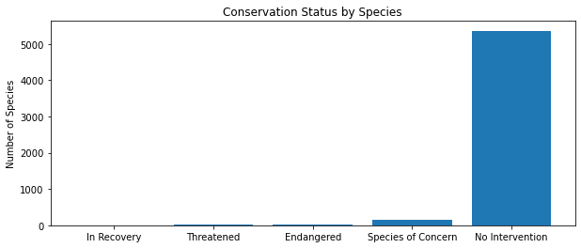
Data Analysis – species_info.csv
Key Points –
Graphic shows the conservation status of species in the dataframe.
Most species fall into “No Intervention”

Slide 5
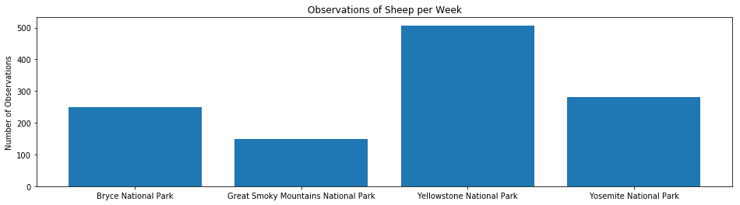
Data Analysis – observations.csv
Key Points –
Graphic shows the number of observations of Sheep and National Parks
Yellowstone currently has the largest number of observations

Slide 6
Recommendations
Continue to collect data from Yellowstone National Park to validate projections for needed sample size.
Validate that foot and mouth disease for sheep for reduction of 5%
Collect data for a period of 1.75 weeks to achieve necessary sample size of 890.

